Slide 1


Using business rules and data services
to gain customer insight
Phil Simpson, BRMS Product Marketing Manager
Kenneth Peeples, JBoss Technology Evangelist
May 24, 2013

Slide 2
JBoss Fuse Getting Started
Part 1 – Business Rules Overview – Phil Simpson (20 minutes)
Part 2 – Data Services Overview – Kenneth Peeples (10 minutes)
Part 3 - Demonstration of using Business Rules with Enterprise Data Services – Kenneth Peeples (20 minutes)
Part 4 – Question and Answer Session - Phil and Kenneth (10 minutes)

Slide 3

Part 2: Data Services Overview – Kenneth Peeples

Slide 4
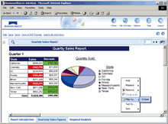
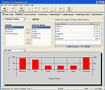

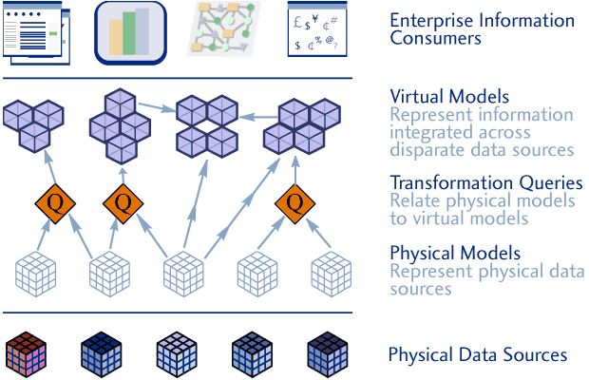
JBoss Enterprise Data Services
  Turn the data you have into the information you want.
  Standards-based read/write access to heterogeneous data stores in real time.
  Speeds application development by simplifying access to distributed data.
  Transforms data structure and semantics through data virtualization.
  Consolidates data into a “single view” without the need for more data.
  Centralized access control, auditing through robust security infrastructure.
  Creates services that provision data to business process in your SOA.
  Enterprise-proven – flexible, scalable, high-performance.
SQL
Web
Services
Data Service
Data Service
Data Service
JBoss Enterprise
Data Services

Slide 5
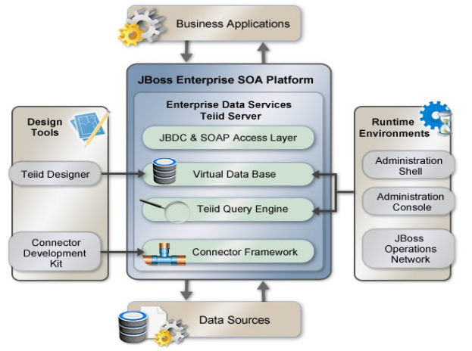
Data Services (Teiid) Architecture
JBoss Enterprise Data Services Platform is a data federation and virtualization engine (the Teiid Server) that allows you to query multiple data sources (RDBMSs, web services, files, applications, etc) as though they were a single unified source.
It builds on the JBoss EAP and SOA Platforms and includes model-driven development tools and rich management capabilities along with a robust runtime
The Teiid Server Runtime executes as an additional service/capability within the JBoss container.

Slide 6
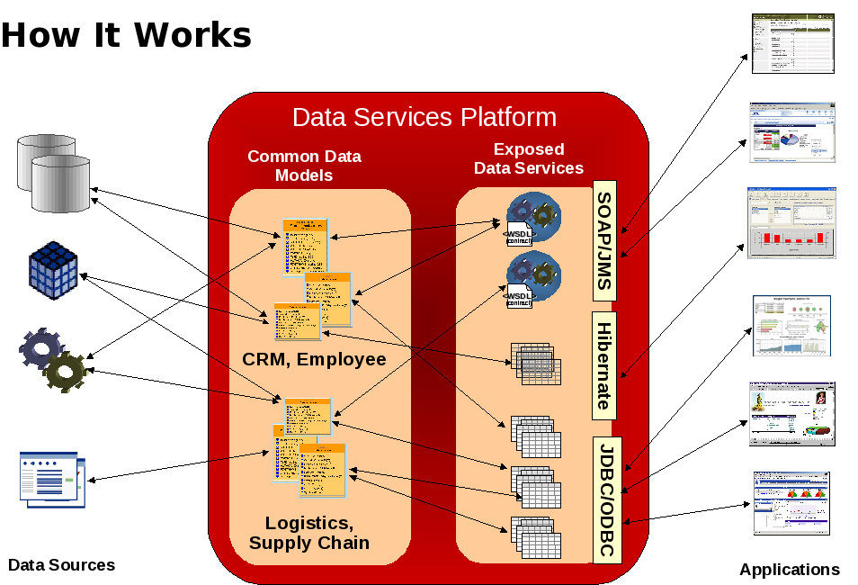

Slide 7
What does Data Services/Teiid do?
Data Virtualization, with a focus on optimized real-time access.
Like a database, but the planner and optimizer are geared to data integration.
  Query decomposition/push-down
  XA Transactions for writes
Convenient relational abstraction with lots of other features
  XML Document Models
  SQL Views, Procedure language, XQuery integration
  Available as a JDBC driver, includes optional ODBC driver
  Built-in integration with RDBMSs, XML sources, LDAP, Salesforce, Services etc.
Tight integration with Teiid Designer

Slide 8
What does Teiid Designer do?
Creates source models
  By importing metadata
  By manually defining metadata
Creates view models
Creates Virtual Databases (VDB)
Uses Teiid (integrated with the Designer) to allow querying models prior to deployment

Slide 9
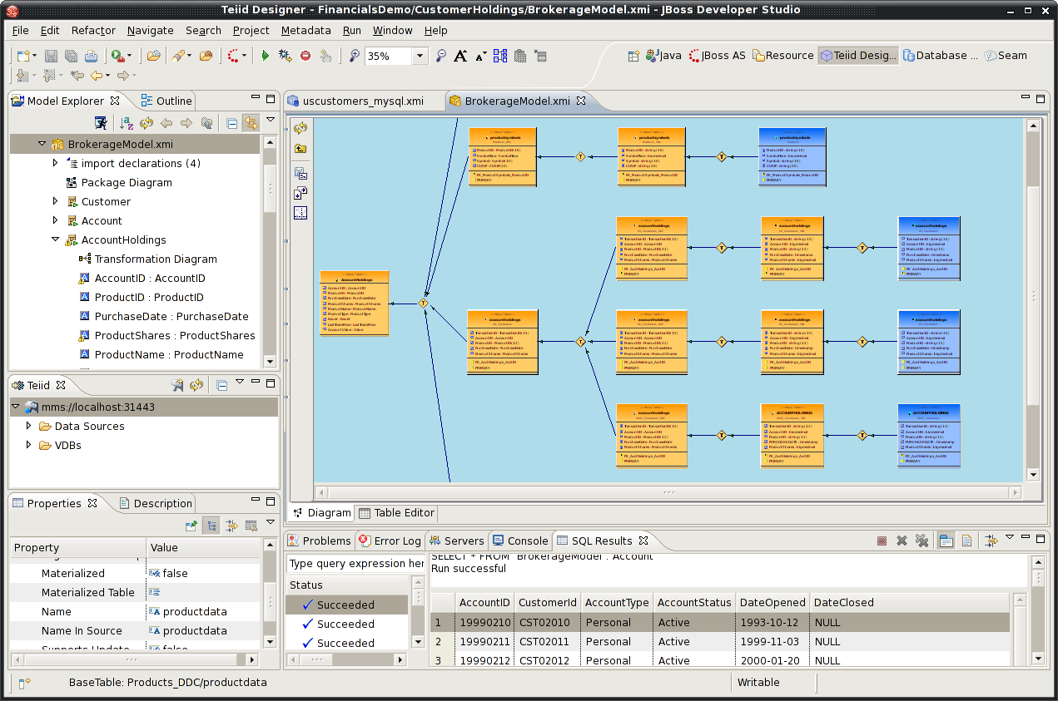
JBoss Developer Studio - Designer Tooling
Logical Models
Physical Models representing
actual data sources
Shows structural transformations
Defines transformations with
  Selects
  Joins
  Criteria
  Functions
  Unions
  User Defined

Slide 10
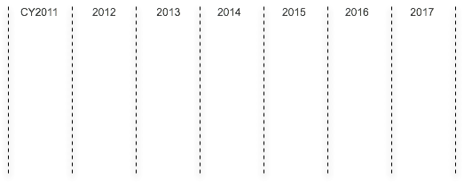


JBoss Enterprise Data Services Roadmap
Subject to Change
EDS-P 5
5.2
5.3
5.3.1
EDS-P 6
6.0
EDS 5.3.1 (Released Feb/CY13)
Java 1.7 support
Additional certifications
Fixes/updates
EDS 6.0 (Target : Q4/CY13)
Teiid 8, S-RAMP/ModeShape 3.
Lightweight footprint / EAP 6
Decoupling from SOA runtime
Updated tooling
Many new features

Slide 11
Upcoming New Features
DDL Based View Definitions in Dynamic VDBs
VDB import/reuse
VDB deployment improvements
Native Queries
OData Support
Procedure Exception Handling
NoSQL sources
JSON production
Source temporary tables
Teiid Designer 8
OpenShift
You can access these features in Teiid community releases now
Notes:
Performance of the runtime system is always important .
There may be situation where you have a very slow, or restrictive access to system, un reliable and your data staleness tolerance is more and performance requirements are higher, then the answer is to materialize the view data in EDS.
Materialization is process of caching the view data contents for a defined amount time and using this cached data for the future user queries.

Slide 12

DDL-based Dynamic View Creation
Unique among data virtualization technologies/vendors
Programmatic configuration
In Teiid 7.7/EDS 5.x, DDL could only specify integration between multiple physical sources.
In Teiid 8/EDS 6, DDL can be used to specify view definitions.
Notes:
Is the ability to create abstract views dynamically at runtime based on the metadata from other sources programatically.
We are the only vendor that has this capability.
Why would you need it? More to come here...

Slide 13
VDB Import/Reuse Feature
RDBMS
VDB 1
Flat File
combined
Client
Application
VDB1
VDB2
Flat File
VDB2
Services

Slide 14
VDB Imports/Reuse
Enables and promotes enterprise/project/domain wide canonical data model
Hides the complexity from application developers
Improves the performance when “stacking” VDBs
Treats it as single source
Keeps one copy of materialization results per VDB

Slide 15
Native Query Support
Source Table Metadata
Specified as metadata property on source table:
  native-query="select c from g"
Produces source query with inline view:
  "SELECT c FROM (select c from g) as x"
Native() Procedure
Allow ad-hoc native SQL to be passed to source. Metadata structure defined at execution.
  SELECT x.* FROM (call pm1.native('select * from g1')) w,
ARRAYTABLE(w.tuple COLUMNS "e1" integer , "e2" string) AS x

Slide 16
PARTICIPATION IN STANDARDS BODIES
OData (OASIS Open Data Protocol)
https://www.oasis-open.org/committees/tc_home.php?wg_abbrev=odata
Objective: OASIS OData TC works to simplify the querying and sharing of data across disparate applications and multiple stakeholders for re-use in the enterprise, Cloud, and mobile devices. A REST-based protocol, OData builds on HTTP, AtomPub, and JSON using URIs to address and access data feed resources. It enables information to be accessed from a variety of sources including (but not limited to) relational databases, file systems, content management systems, and traditional Web sites.
S-RAMP (OASIS SOA Repository Artifact Model and Protocol)
https://s-ramp.org
http://github.com/governance
Objective: define common data model and APIs to store and manage SOA artifacts throughout their lifecycle.

Slide 17
Part 3: Demonstration of using Business Rules with Enterprise Data Services – Kenneth Peeples

Slide 18
Topics Covered to build the example project
1) Show multiple data sources with EDS including salesforce.com and text file
2) Show how to use business rules with the data
3) Show how to build, deploy and test the project through the IDE

Slide 19
Prerequisites
Source to be posted with Video
Maven 3.0.3 or higher
JDK 1.7
JBoss Developer Studio 6
JBoss SOA-P 5
https://github.com/kpeeples/eds-brms-salesforce.git

Slide 20
Steps to create the example project
Scope: Get opportunities from a salesforce.com VDB with a opportunity line items that match the product codes from a text file VDB and then execute a business rule to find those opportunities with total price above 100k.
Step 1 – Setup salesforce.com developer account with token for API access
http://www.ossmentor.com/2013/05/using-enterprise-data-services-teiid-to.html

Slide 21
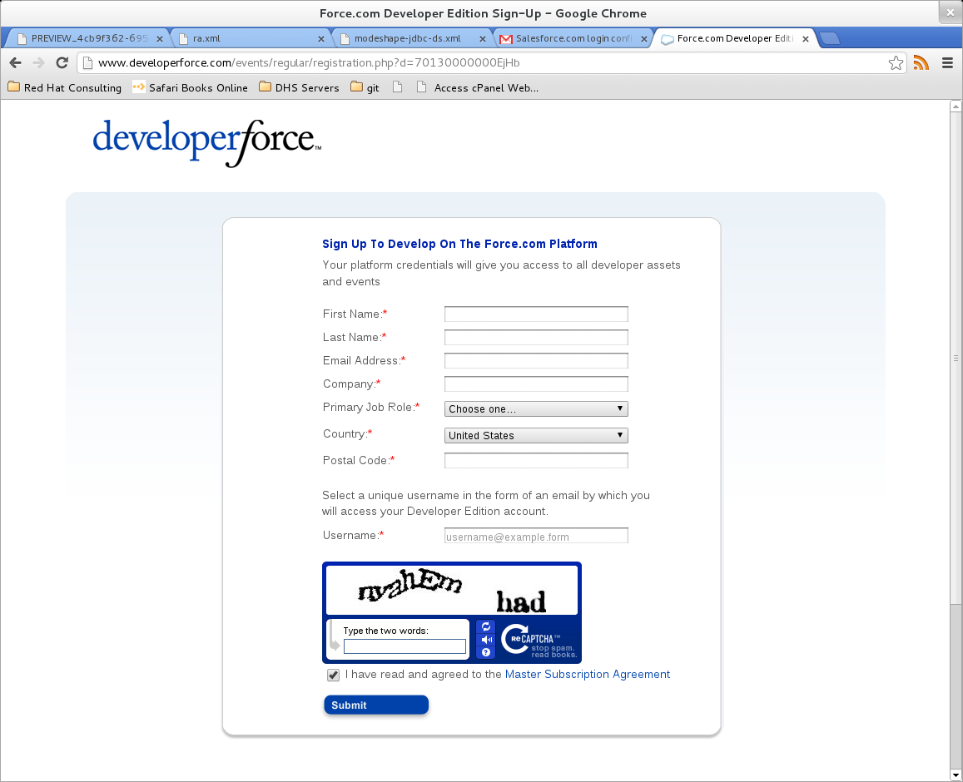
Create a Developer Force Account

Slide 22
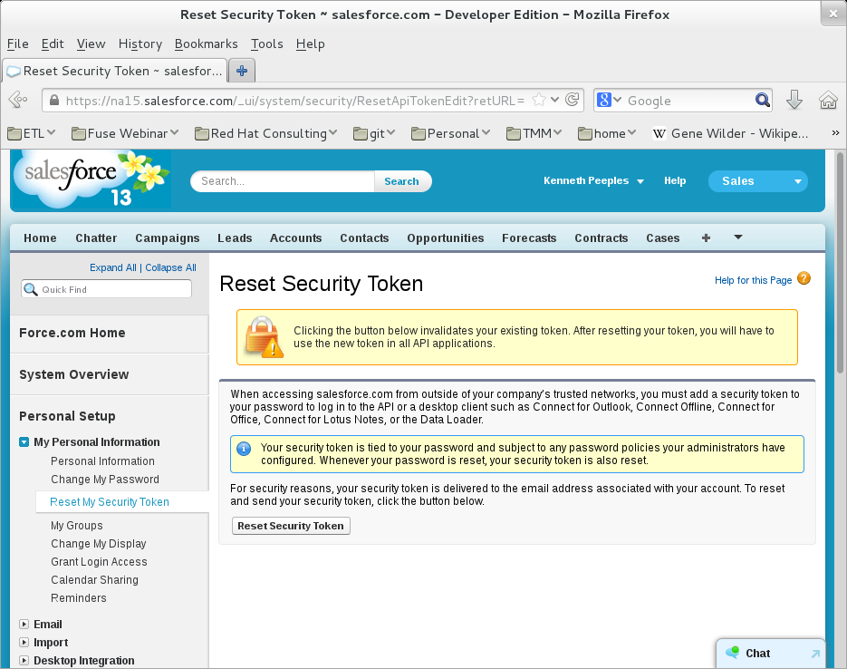
Reset Security Token

Slide 23
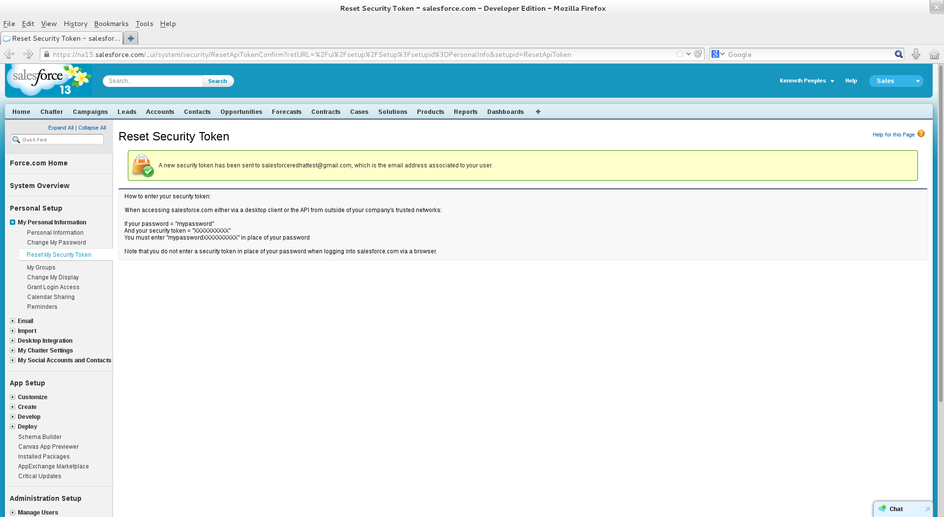
Token Reset

Slide 24
Steps to create the example project
Step 2 – Build and deploy the data source and VDB for Salesforce.com and text file
Import from salesforce to build source model
Import from Text file, which will build a source model (which has the getTextFiles function) and a view model for viewing the contents of the file
Package VDB to include salesforce and text file models, and then deploy the VDB
https://community.jboss.org/wiki/ConnectToSalesforceUsingTeiid
http://docs.jboss.org/teiid/7.0.0/quick-start-example/en-US/pdf/teiid_quick_start_example.pdf

Slide 25
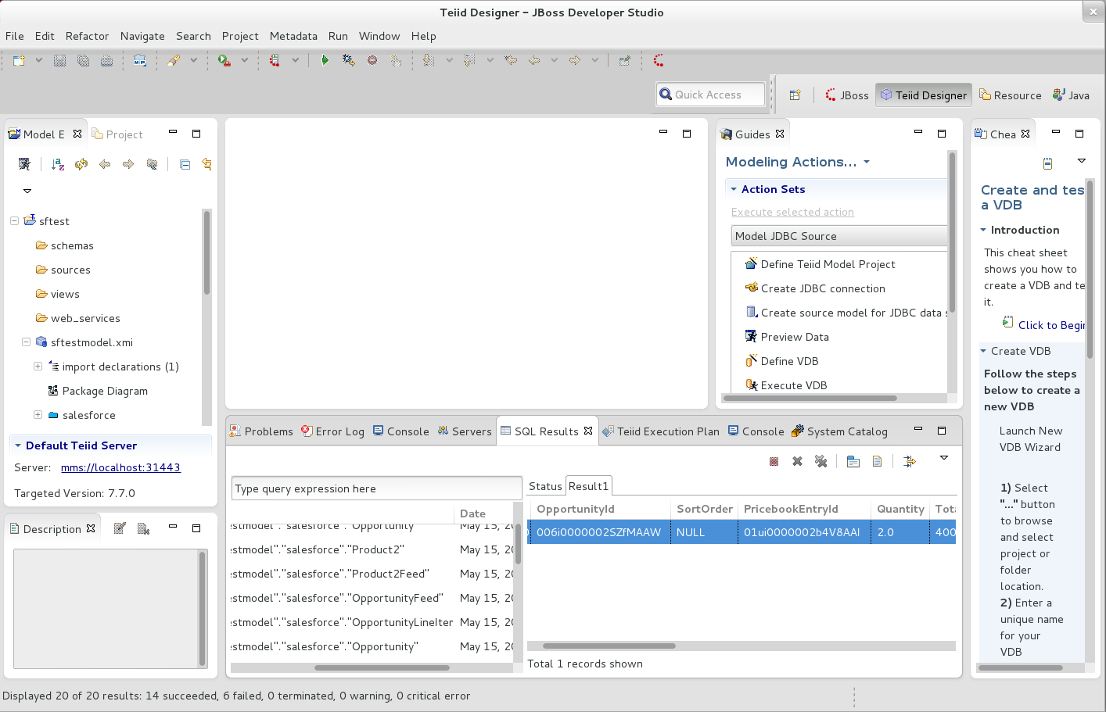

Slide 26
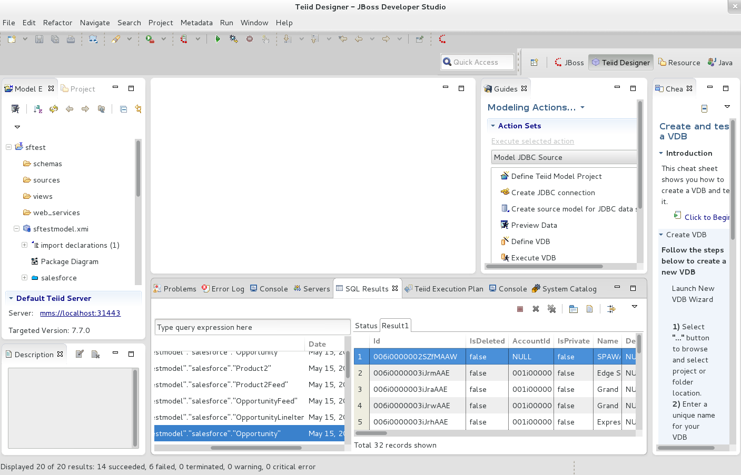

Slide 27
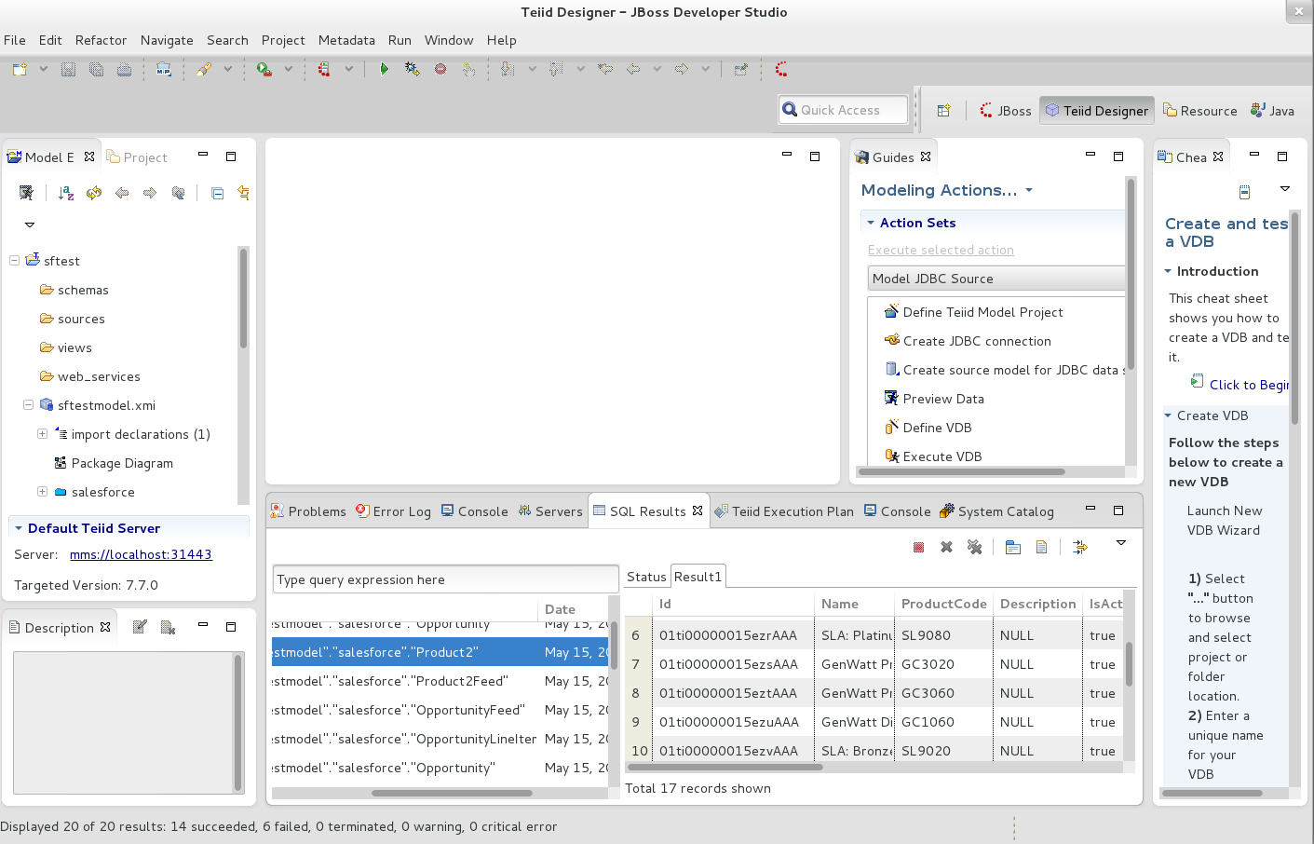

Slide 28
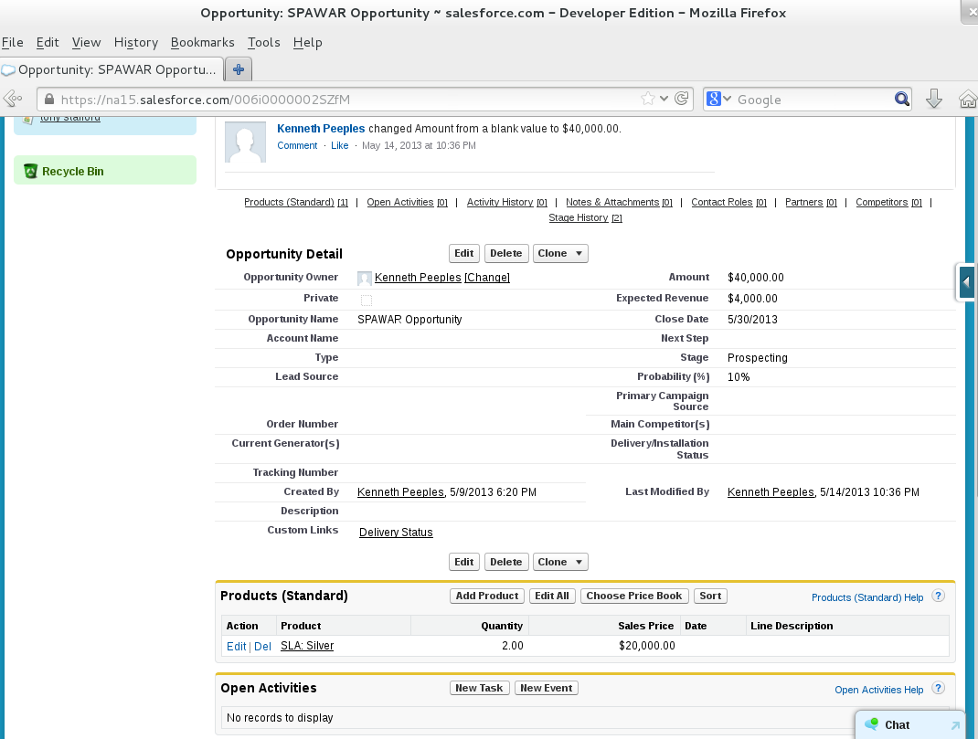

Slide 29
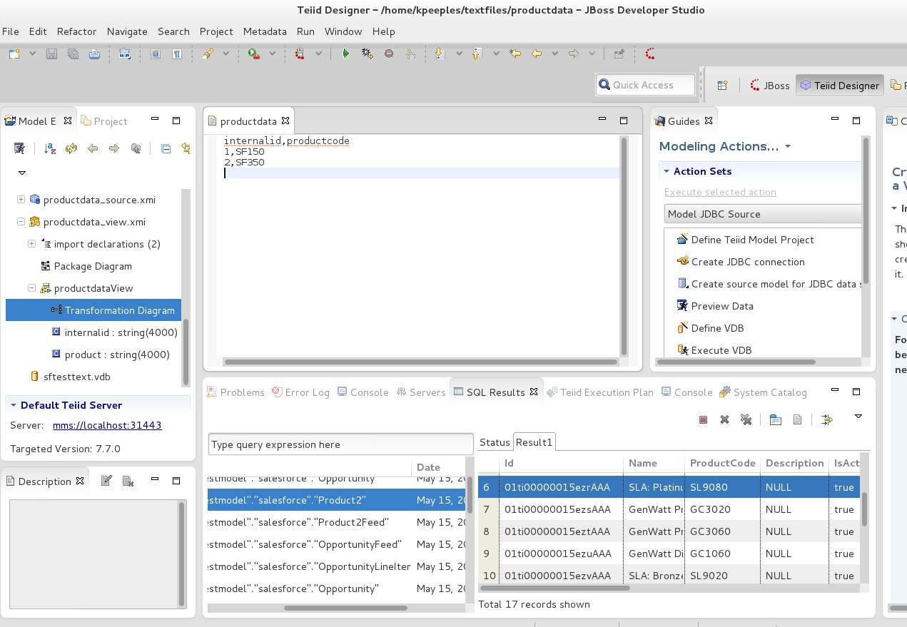

Slide 30
Steps to create the example project
Step 3 – Build the POJO's
Step 4 – Build the business rule that will verify the opportunities with products with a total price above 100k
-package POJO's and .drl rules file into jar
-deploy jar (place in the server/<config>/lib directory
Step 5 – Execute the business rule
http://docs.jboss.org/drools/release/5.5.0.Final/drools-expert-docs/html_single/index.html#d0e8782

Slide 31
Teiid v8 (EDS 6) Quickstart with drools integration
Demonstrates how to integrate drools so that business rules can be triggered based on the data moving through Teiid by using a UDF (User Defined Function)
This quick start demonstrates one way to execute a set of business rules on a set of data. In this example, the execution of the rules will be triggered by calling the UDF (User Defined Function) from a virtual procedure, capturing the errors that occurred, and returning that error list to the client.
https://github.com/teiid/teiid-quickstarts/tree/master/drools-integration

Slide 32
References
OSSMentor Teiid Salesforce Integration
http://www.ossmentor.com/2013/05/using-enterprise-data-services-teiid-to.html
Quickstart Guide
https://community.jboss.org/wiki/TeiidDesigner77QuickStartGuide
Quick Start Samples
http://docs.jboss.org/teiid/7.7.0.Final/quick-start-example/en-US/html/example-explained.html
EDS Lab
http://www.jboss.com/pdf/tyrrell_wt_lab_enterprise_data_services.pdf
Drools Article
http://java.dzone.com/articles/jbossesb-drools-integration
Teiid Quickstart Repository
https://github.com/teiid/teiid-quickstarts.git - drools integration

Slide 33
Contact Information
Phil Simpson
Product Marketing Manager
psimpson@redhat.com
Kenneth W. Peeples, C|HFI, Security+
JBoss Technology Evangelist
OASIS and OMG Member
kpeeples@redhat.com

Slide 34
Part 4: Question and Answer

